Slide 1

Introduction
Image Sensing & Digitization
From Photons to Digital Pixels

Slide 2
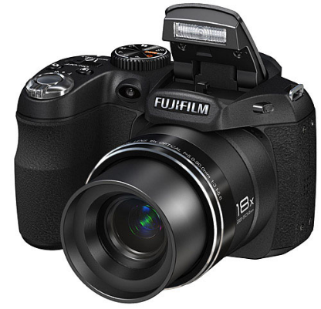
Image Acquisition Fundamentals
Definition:
Image sensing detects information that constitutes an image using specialized physical sensors.
In simple words:
•
It converts continuous physical phenomena (like reflected light) into an analog electrical signal.
•
The process requires an illumination source, object reflection or absorption, and a sensing mechanism.
Sensor Material:
The most common sensor material used for capturing light is the silicon photodiode.
Fig 1: Light entering a camera lens

Slide 3
Sensor Arrangements
Images can be acquired using different sensor configurations depending on the application:
1. Single Sensor
Generates 2D images by mechanical scanning in both x and y directions. It is highly precise but generally a slower method.
2. Line Sensor
Senses a full strip in one direction while mechanical motion operates in the perpendicular direction (e.g., flatbed scanners).
3. Sensor Array
A 2D arrangement that captures the entire image area at once, eliminating the need for complex mechanical motion.

Slide 4
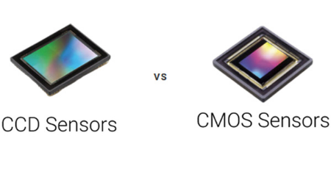
2D Sensor Arrays (Cameras)
How they work:
•
Sensor arrays eliminate the need for mechanical motion to capture a dynamic 2D scene.
•
Common technologies include CCD (Charge-Coupled Device) and CMOS arrays found in digital cameras.
Signal Generation:
•
Each array element responds to incident light by accumulating an electrical charge proportional to the energy.
Fig 2: 2D Sensor Array Chip
•
The array acts as the focal plane, generating a continuous analog voltage output for the entire scene.

Slide 5
The Need for Digitization
To process images on a computer, the analog signal from sensors must be digitized in two ways:
Spatial Digitization (Sampling)
The output of a sensor array is spatially continuous. We must convert this continuous physical plane into a discrete grid structure suitable for computer processing and storage.
Amplitude Digitization (Quantization)
The voltage values representing brightness are analog and continuous. These continuous waveforms must be mathematically mapped to discrete, finite digital steps.

Slide 6
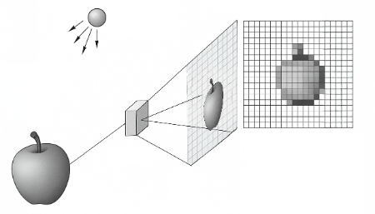
Sampling: Defining the Pixels
Process:
•
Sampling involves discretizing the spatial coordinates (x, y) of the continuous image scene.
•
It transforms a continuous visual field into a grid of discrete picture elements, known as "pixels".
Impact on Quality:
•
The density of this grid determines the image's overall spatial resolution and level of detail.
•
Higher sampling rates capture finer variations but significantly increase file size and required storage.
Fig 3: Continuous image mapped to pixel grid

Slide 7
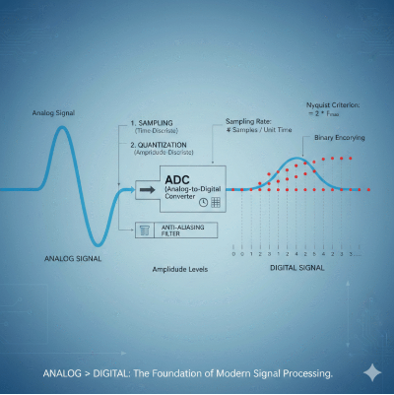
Quantization: Assigning Values
Process:
•
Quantization converts continuous amplitude (voltage) from each pixel into a discrete digital value.
•
Each pixel's intensity is mapped to the nearest integer within a defined scale (e.g., 0 to 255 for 8-bit).
Impact on Quality:
•
This critical step establishes the grayscale depth or color resolution of the final digital image.
•
Using limited quantization levels can cause visible artifacts, such as false contouring or banding.
Fig 4: Mapping analog wave to discrete values

Slide 8

The Image Processing Pipeline
Continuous Scene
↓
Sensor Array
↓
Analog Signal
↓
Sampling & Quantization
↓
Digital Pixels

Slide 9

Image Sources
https://www.picturecorrect.com/fujifilm-finepix-s4000-s3200-and-s2950/fujifilm-s2950/
Source: www.picturecorrect.com
https://www.teledynevisionsolutions.com/globalassets/tvs/learn/dalsa/ccd-vs-cmos/thumb-screenshot-2023-10-24-104441.jpg
Source: www.teledynevisionsolutions.com
https://sigmoidal.ai/wp-content/uploads/2025/06/Sampling-and-Quantization-1.png
Source: sigmoidal.ai
https://zeroinstrument.com/wp-content/uploads/2026/02/Understanding-Sampling-and-Signal-Conversion-From-Analog-to-Digital-768x768.png
Source: zeroinstrument.com

Slide 10




Image Sources
https://www.picturecorrect.com/fujifilm-finepix-s4000-s3200-and-s2950/fujifilm-s2950/
Source: www.picturecorrect.com
https://www.teledynevisionsolutions.com/globalassets/tvs/learn/dalsa/ccd-vs-cmos/thumb-screenshot-2023-10-24-104441.jpg
Source: www.teledynevisionsolutions.com
https://sigmoidal.ai/wp-content/uploads/2025/06/Sampling-and-Quantization-1.png
Source: sigmoidal.ai
https://zeroinstrument.com/wp-content/uploads/2026/02/Understanding-Sampling-and-Signal-Conversion-From-Analog-to-Digital-768x768.png
Source: zeroinstrument.com

